Slide 1
PeopleRank: Social Opportunistic Forwarding

Slide 2

Algorithm
PeopleRank is inspired by the PageRank algorithm employed by Google to rank web pages
people favorites
you may interesting
Fig 1. recommended channel by Youtube

Slide 3
Algorithm (cont.)
Centralized PeopleRank
Distributed PeopleRank

Slide 4
Centralized PeopleRank
important
a person randomly clicking on links will arrive at any particular page
3
important
important
important
2
4
1
Rank value
Rank value
5
Other nodes
important

Slide 5
12/18

Slide 6
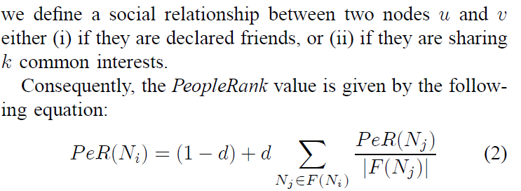
Centralized PeopleRank
K=2
d: damping factor (0.8~0.87) F(N): the set of friends that links to N |F(N)|: the number of friends

Slide 7
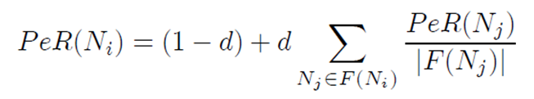
The PeopleRank Value
PR(I) = ?
PR(J) = 4
1
I
J
PR(I) = (1-0.85) + 0.85*(4/10)
= 0.49
2
9

Slide 8
The PeopleRank Value(cont.)
PR(I) = ?
PR(J) = 4
1
I
J
PR(I) = (1-0.85) + 0.85*[(4/10)+(4/10)]
= 0.83
2
PR(K) = 4
1
K
9
2
朋友越多,PeopleRank Value越高
9

Slide 9
Distributed PeopleRank
Whenever two neighbor nodes in the social graph meet, they exchange two pieces of information:
(i) their current PeopleRank values;
(ii) the number of social graph neighbors they have.

Slide 10
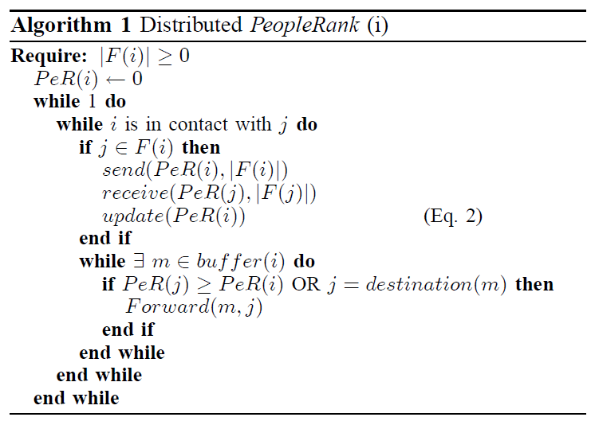
Distributed PeopleRank Algo.

Slide 11
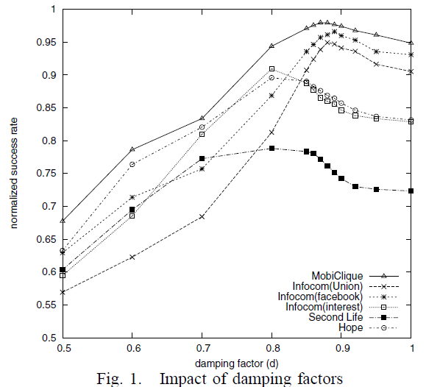
Impact of damping factors
Explicitly defined connections: MobiClique , Infocom(facebook) , Infocom(facebook) only when the two nodes declared a direct connection (ex. Links in applications like Facebook) optimal damping factor around 0.87
Implicit social connections: Hope , SecondLife , Infocom(interest)
connections are defined as contacts between persons that sharing some common interests optimal damping factor around 0.8

